Slide 1
Programming Principles and Techniques
ARRAYS
Notes:
1-13

Slide 2
Learning Outcomes
By the end of this session, you should be able to:
Declare and initialize an array in C.
Apply array concept to solve the problem.
apply array in function
Notes:
1-13

Slide 3
Introduction
In C programming, one of the frequently arising problem is to handle similar types of data.
For example:
If the user want to store marks of 100 students. This can be done by creating 100 variable individually but, this process is rather tedious and impracticable. These type of problem can be handled in C programming using arrays.
Notes:
1-13

Slide 4
What is an Arrays?
An array is a sequence of data item of homogeneous value(same type).
two types of Arrays:
One-dimensional arrays
Multidimensional arrays

Slide 5


Declaration of one-dimensional array
data_type array_name[array_size];
For example: int age[5];
int age[5]={2,4,34,3,4}; or
int age[]={2,4,34,3,4};
Notes:
1-13

Slide 6
Accessing array elements
scanf("%d",&age[2]);
/* statement to insert value in the third element of array age[ ]. */
scanf("%d",&age[i]);
/* Statement to insert value in (i+1)th element of array age[ ]. */
/* Because, the first element of array is age[0], second is age[1], ith is age[i-1] and (i+1)th is age[i]. */
printf("%d",age[0]);
/* statement to print first element of an array. */
printf("%d",age[i]);
/* statement to print (i+1)th element of an array. */
Notes:
1-13

Slide 7
Example of array in C programming
/* C program to find the sum marks of n students using arrays */
#include <stdio.h>
int main()
{ int marks[10],i,n,sum=0;
printf("Enter number of students: ");
scanf("%d",&n);
for(i=0;i<n;++i)
{
printf("Enter marks of student%d: ", i+1);
scanf("%d",&marks[i]);
sum+=marks[i];
}
printf("Sum= %d",sum);
return 0;
}
<number> - 13
Notes:
1-13

Slide 8
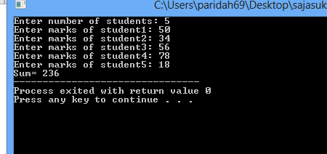
Output
Enter number of students: 3
Enter marks of student1: 12
Enter marks of student2: 31
Enter marks of student3: 2
sum=45
Notes:
Important thing to remember in C arrays Suppose, yoeclared the array of 10 students. For example: arr[10]. You can use array members from arr[0] to arr[9]. But, what if you want to use element arr[10], arr[13] etc. Compiler may not show error using these elements but, may cause fatal error during program execution.
1-13

Slide 9
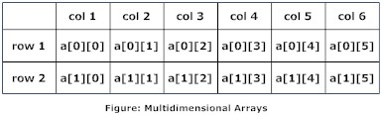
C Programming Multidimensional Arrays
Array data type
for example:
float a[2][6];
Number of row
Number of column
Array name
Notes:
Here, a is an array of two dimension, which is an example of multidimensional array. This array has 2 rows and 6 columns For better understanding of multidimensional arrays, array elements of above example can be thinked of as below:
1-13

Slide 10
Initialization of Multidimensional Arrays
int c[2][3]={{1,3,0}, {-1,5,9}};
OR
int c[][3]={{1,3,0}, {-1,5,9}};
OR
int c[2][3]={1,3,0,-1,5,9};
Notes:
1-13

Slide 11
C program to Calculate the Power of a Number
This program below takes two integers from user, a base number and an exponent. For example: In case of 23, 2 is the base number and 3 is the exponent of that number. And this program calculates the value of base- exponent.
Expected Output
Enter base number and exponent respectively: 3 4
Answer = 81
How to solve this problem????
Notes:
1-13

Slide 12
Source Code to Calculate Power
/* C program to calculate the power of an integer*/
#include <stdio.h>
int main()
{ int base, exp;
long long int value=1;
printf("Enter base number and exponent respectively: ");
scanf("%d%d", &base, &exp);
while (exp!=0)
{ value*=base; /* value = value*base; */
- - exp; }
printf("Answer = %d", value); }
Notes:
Explanation
This program takes base number and exponent from user and stores in variable base and exp respectively. Let us suppose, user entered 3 and 4 respectively. Then, while loop is executed with test condition exp!=0. This test condition will be true and value becomes 3 after first iteration and value of exp will be decreased to 3. This process goes on and after fourth iteration, value will be equal to 81(3*3*3*3) and exp will be equal to 0 and while loop will be terminated. Here, we have declared variable value of type long long int because power of a number can be very large.
This program can only calculate the power if base power and exponent are integers. If you need to the calculate power of a floating point number then, you can use pow() function.
1-13

Slide 13
How to read and write in array
#include <stdio.h>
main()
{
int x[10], y, i; /*local variable*/
printf("enter the number of data you want to enter: ");
scanf(" %d", &y);
for(i = 0; i <y; i++)
scanf(" %d", &x[i]);
for(i = 0; i < y; i++)
printf(" Element x[%d] = %d\n",i, x[i]);
return 0;
}
To read data & hold into the x array
Print data from the x array
Notes:
1-13

Slide 14
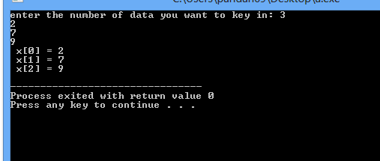
Output:

Slide 15
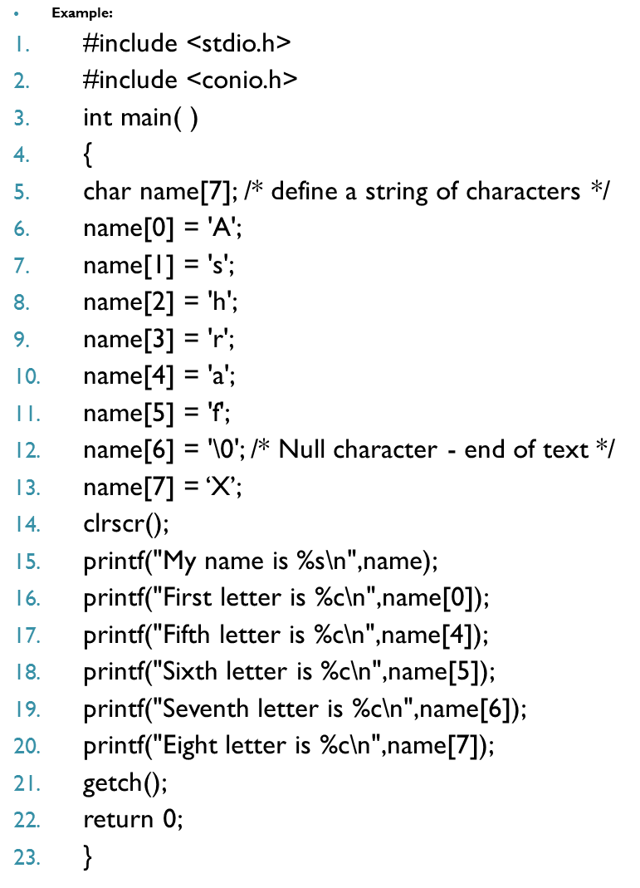

Slide 16
output
My name is Ashraf
First letter is A
Fifth letter is a
Sixth letter is f
Seventh letter is Null
Eight letter is X

Slide 17
problem
Write a program by using an arrays to reverse the number as follows:
6
5
4
After reversal
4
5
6

